Slide 1
IOT Based Smart Restaurant Menu Using Beaglebone Black Wireless Task Interfacing Touch Screen Display with BB-WI
Submitted to:
Prof. Mike Aleshams
Submitted by:
Ramandeep Kaur
Group 3

Slide 2
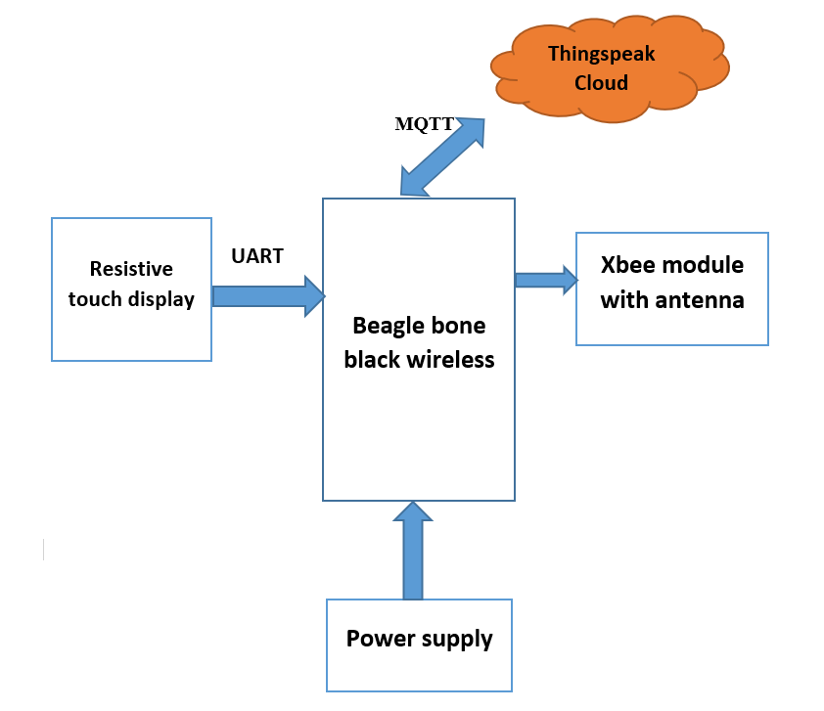
Block Diagram (Transmitter Side)

Slide 3
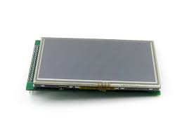
Function of Touch Screen Display
Through touch screen Display, customer can order food items.

Slide 4
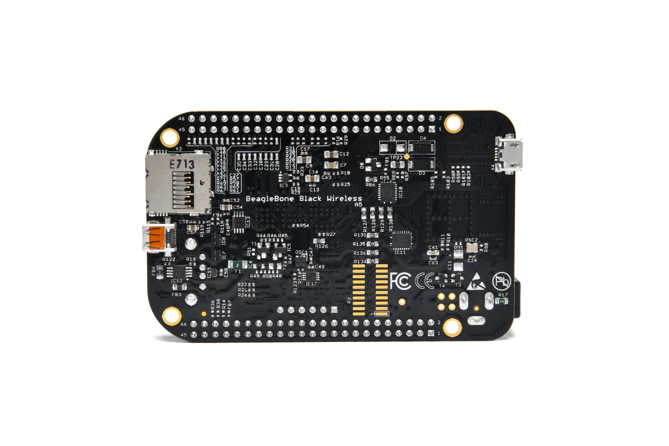
Beaglebone Black Wireless
Based on the extremely successful open-source BeagleBone Black hardware design, BeagleBone Black Wireless is a high-expansion, maker-focused, community-supported open hardware computer created by the BeagleBoard.org Foundation.

Slide 5
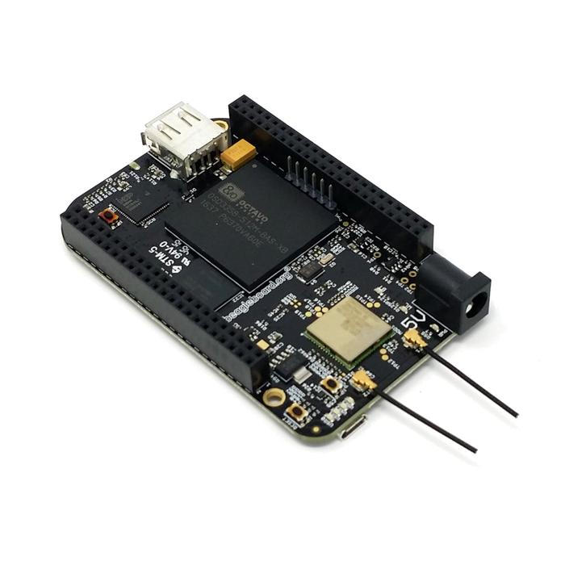
Specifications of BB-WI
512MB DDR3 RAM
4GB 8-bit eMMC on-board flash storage
3D graphics accelerator
NEON floating-point accelerator
2x PRU 32-bit microcontroller
Processor: Octavo systems OSD3358 1GHz ARM Cortex-A8

Slide 6
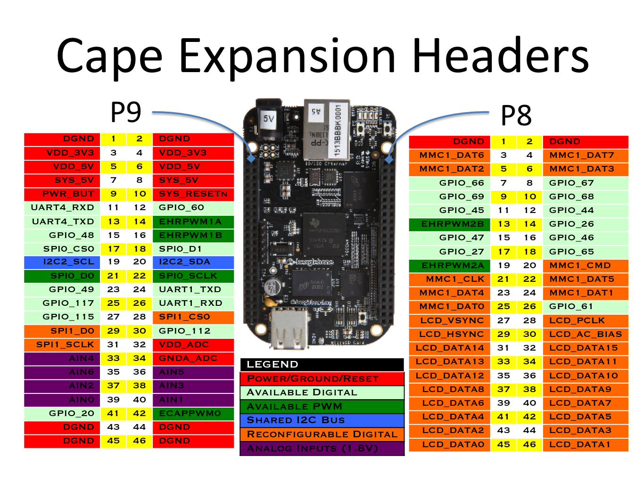
Pin Diagram of Beaglebone Black Wireless

Slide 7
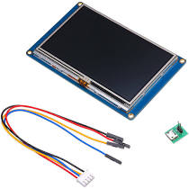
The 4.3’’ Resistive Touch LCD
Nextion NX4827T043 4.3 Inch HMI Intelligent Smart USART UART Serial Touch TFT LCD Screen Module Display Panel:
Nextion is a Seamless Human Machine Interface (HMI) solution that provides a control and visualization interface between a human and a process, machine, application or appliance. It is the best solution to replace the traditional LCD and LED Nixie tube. Nextion includes hardware part (a series of TFT boards) and software part (the Nextion Editor).

Slide 8
The 4.3’’ Resistive Touch LCD
The Nextion TFT board uses only one serial port to communicate. It lets you avoid the hassle of wiring. We notice that most engineers spend much time in application development but get unsatisfactory results. In this situation, Nextion editor has mass components such as button, text, progress bar, slider, instrument panel etc. to enrich your interface design.

Slide 9
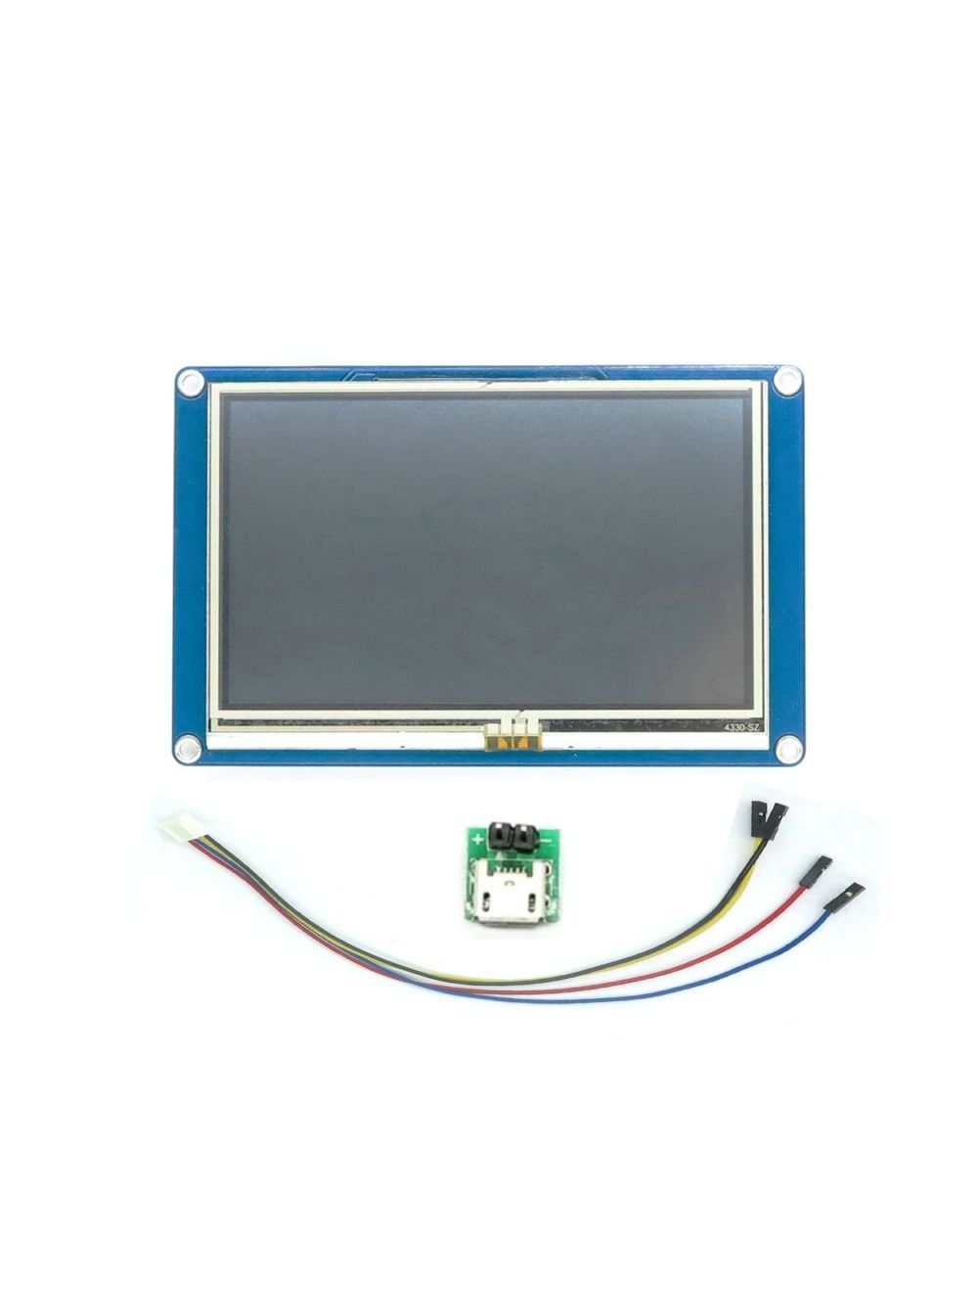
Features
480 x 272 Resolution
RGB 65K true to life colours
TFT Screen with integrated 4-wire Resistive Touch Panel
Easy 4 pin interface to any TTL Serial Host
16M Flash memory for User Application Code and Data
On board micro-SD card for firmware upgrade
Visual Area:95.04mm(L)×53.86mm(W)
Adjustable Brightness:0~230 nit, the interval of adjustment is 1%
5V250mA power consumption

Slide 10
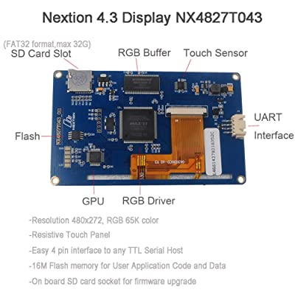
Basic elements of LCD touch screen

Slide 11
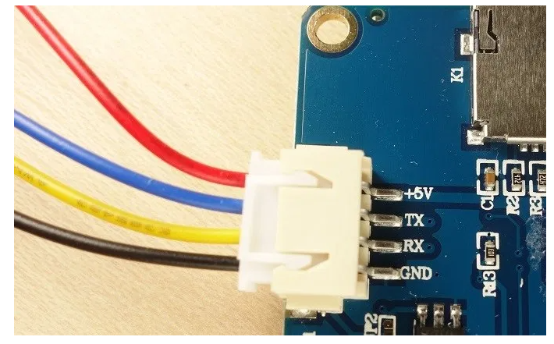
Pins of Touch screen display
Following 4 pins are needed for UART interfacing
1. +5v
2.Tx
3. Rx
4.GND

Slide 12
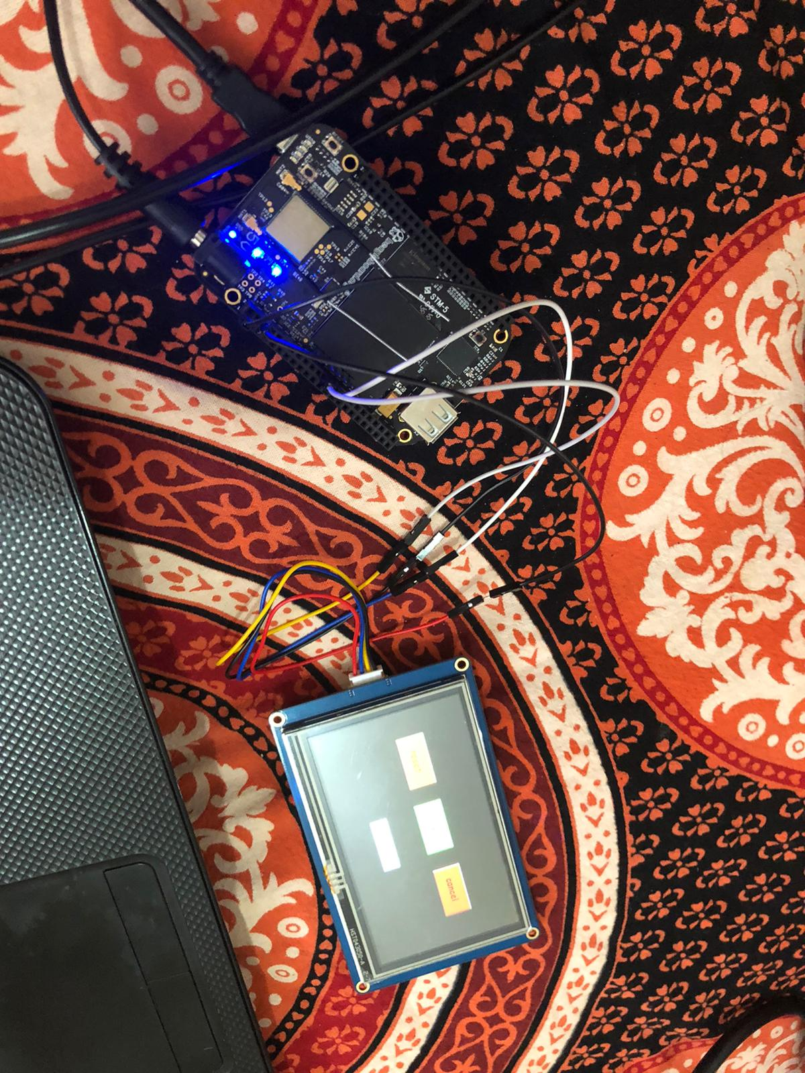
Interfacing Touch Screen Display with BB-WI

Slide 13
Beaglebone Black Wireless | Touch Screen Display
P9_6(VDD_5V) | +5V
P9_1(DGND) | GND
P9_26(UART1_RxD) | Tx
P9_24(UART1_TXD) | Rx

Slide 14
Nextion Editor
Nextion is a Human Machine Interface （HMI） solution combining an onboard processor and memory touch display with Nextion Editor software for HMI GUI project development.
We need Nextion editor for creating GUI on touch screen display.

Slide 15
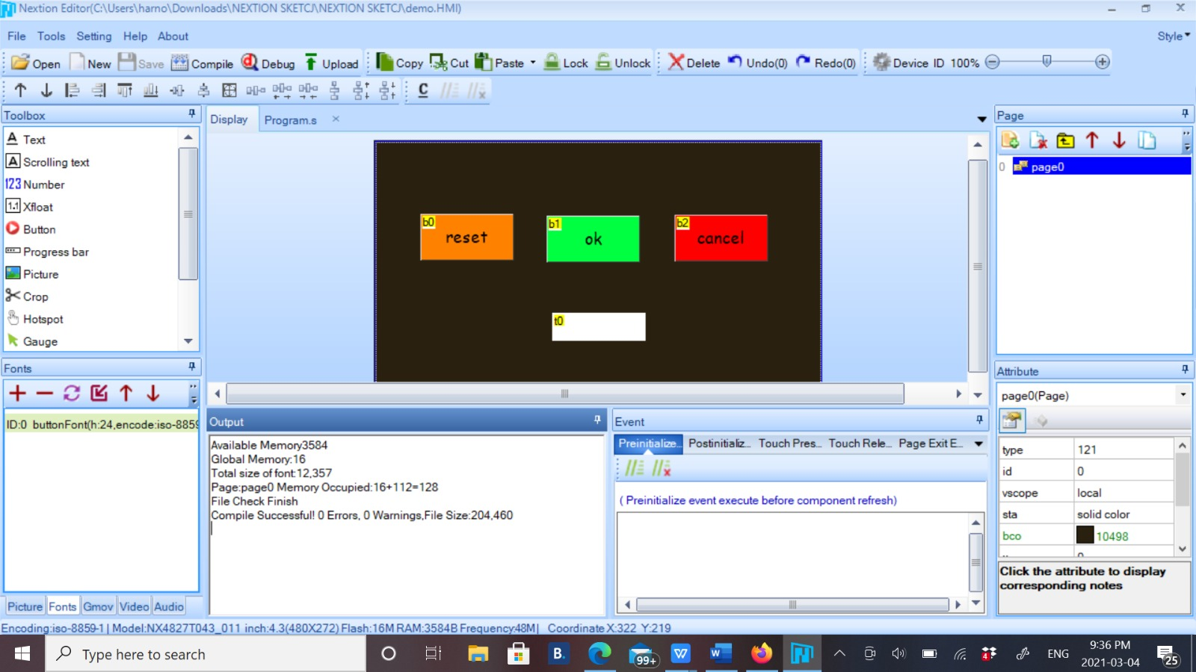
Nextion Editor

Slide 16
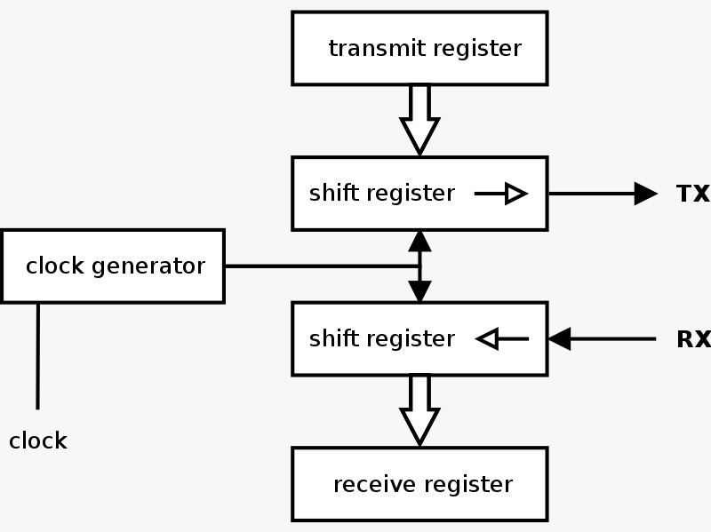
Interfacing communication protocol:UART
A universal asynchronous receiver-transmitter (UART) is a computer hardware device for asynchronous serial communication in which the data format and transmission speeds are configurable.
It sends data bits one by one, from the least significant to the most significant, framed by start and stop bits so that precise timing is handled by the communication channel.

Slide 17
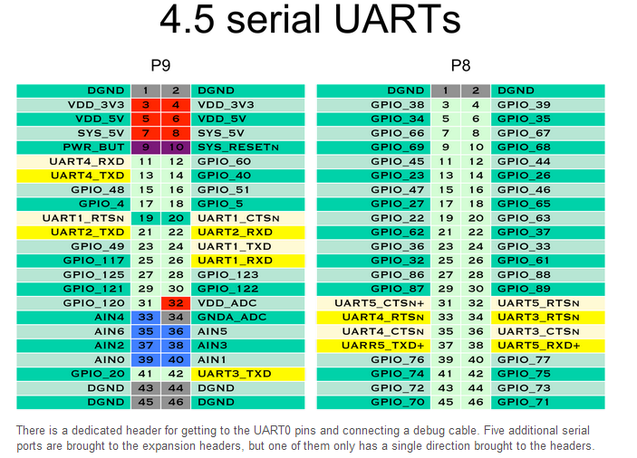
Interfacing communication protocol:UART
Beaglebone Black Wireless have 4.5 serial UARTs.
For interfacing with touch screen display, we can use either of UART1, UART2, UART4.
We cannot use UART3 for interfacing with touch screen display, because UART3 has only transmit pin.

Slide 18
SSH to Beaglebone Black Wireless
Type this command in terminal and make ssh connection to BB-WI
ssh Debian@192.168.7.2
After this, put default password “temppwd”

Slide 19
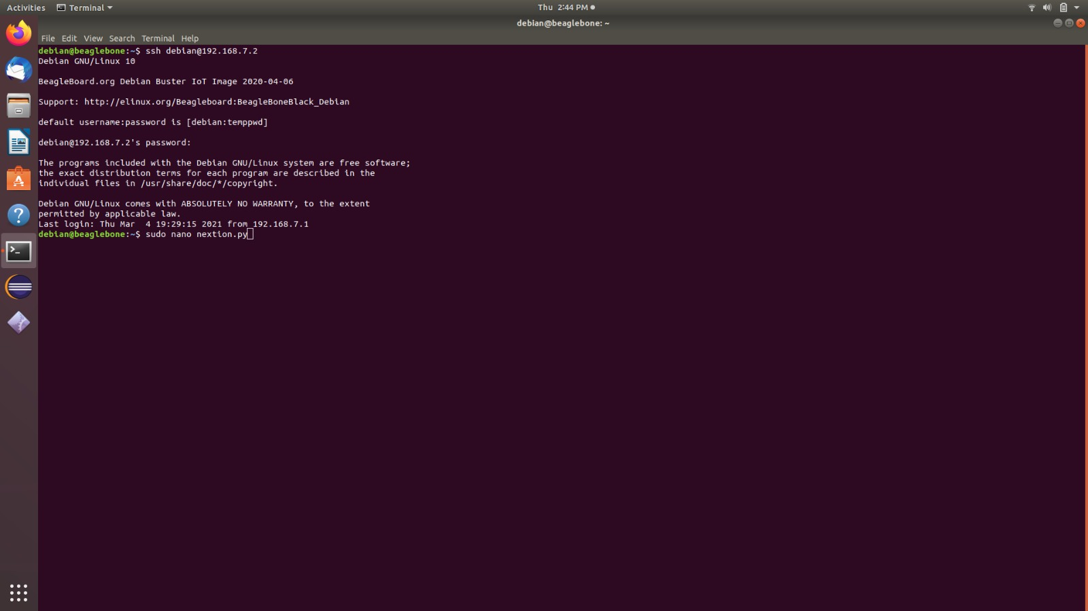
SSH to Beaglebone Black Wireless

Slide 20
Python code for Touch screen Display
Firstly, create a new file in BBB terminal through following command:
Sudo nano <file name>
For Python file, use .py extension with file name

Slide 21
Python code for Touch screen Display

Slide 22
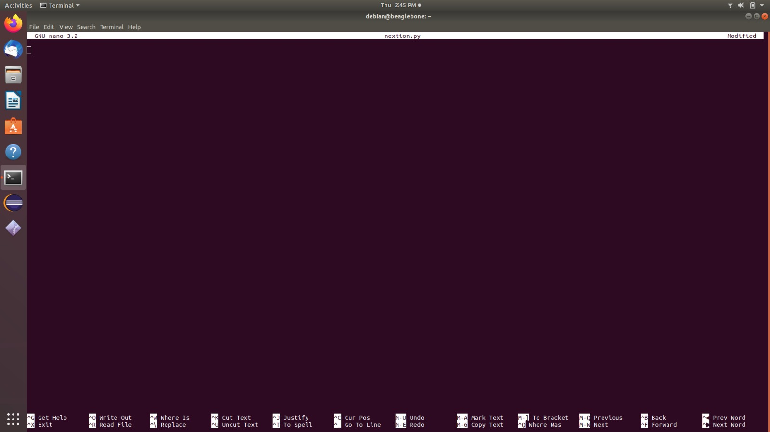
Python code for Touch screen Display

Slide 23
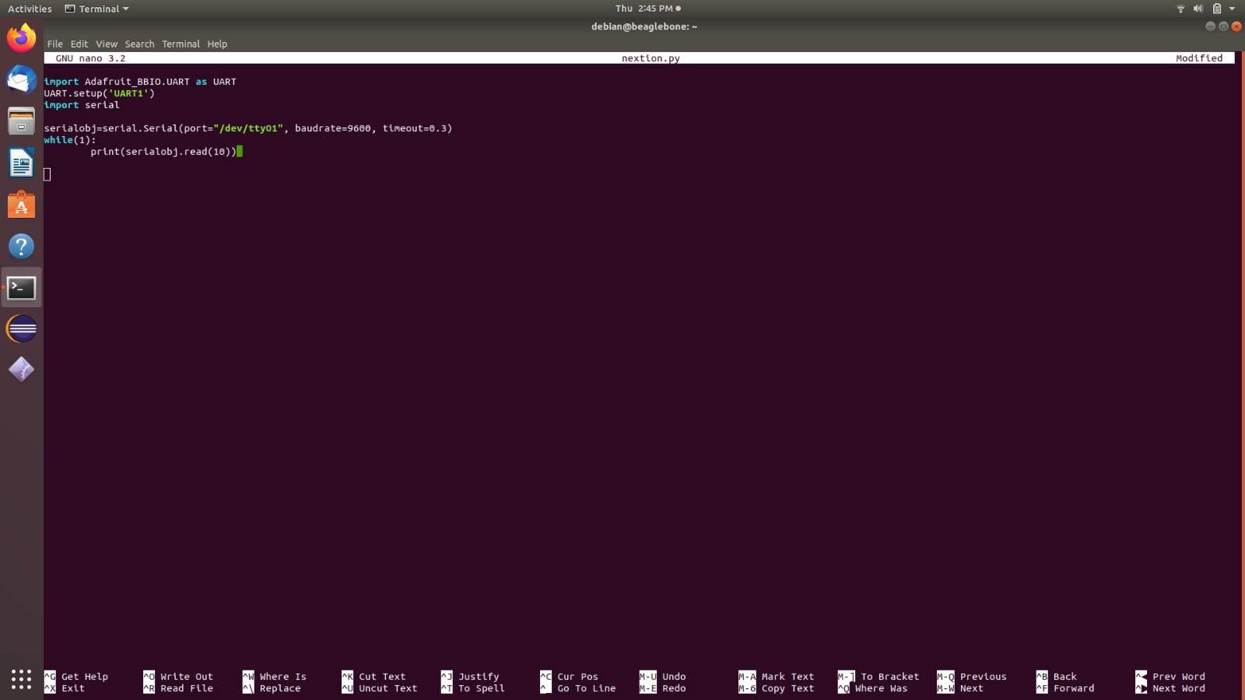
Python code for Touch screen Display

Slide 24
Python code :
import Adafruit_BBIO.UART as UART
UART.setup("UART1")
#These lines used for enabling the UART and importing Adafruit_BBIO library.
Import serial
# For importing serial library, which we need for transmitting and receiving data,
serialobj= serial.Serial(port = "/dev/ttyO1", baudrate=9600, timeout=0.3)
While(1):
print(serialobj.read(10))

Slide 25
Python code:
serialobj= serial.Serial(port = "/dev/ttyO1", baudrate=9600, timeout=0.3)
While(1):
port = "/dev/ttyO1“
#ttyo1 represents UART1
print(serialobj.read(10))
#For printing data on Beaglebone Black Wireless

Slide 26
Download Library
The Adafruit IO Python library will export the UART device tree overlays as a convenience.
import Adafruit_BBIO.UART as UART
UART.setup("UART1")

Slide 27
Download Library
To use UART with python, we can use pyserial module.
We can install it using pip with following command:
pip3 install pyserial
pip is package installer for python.

Slide 28
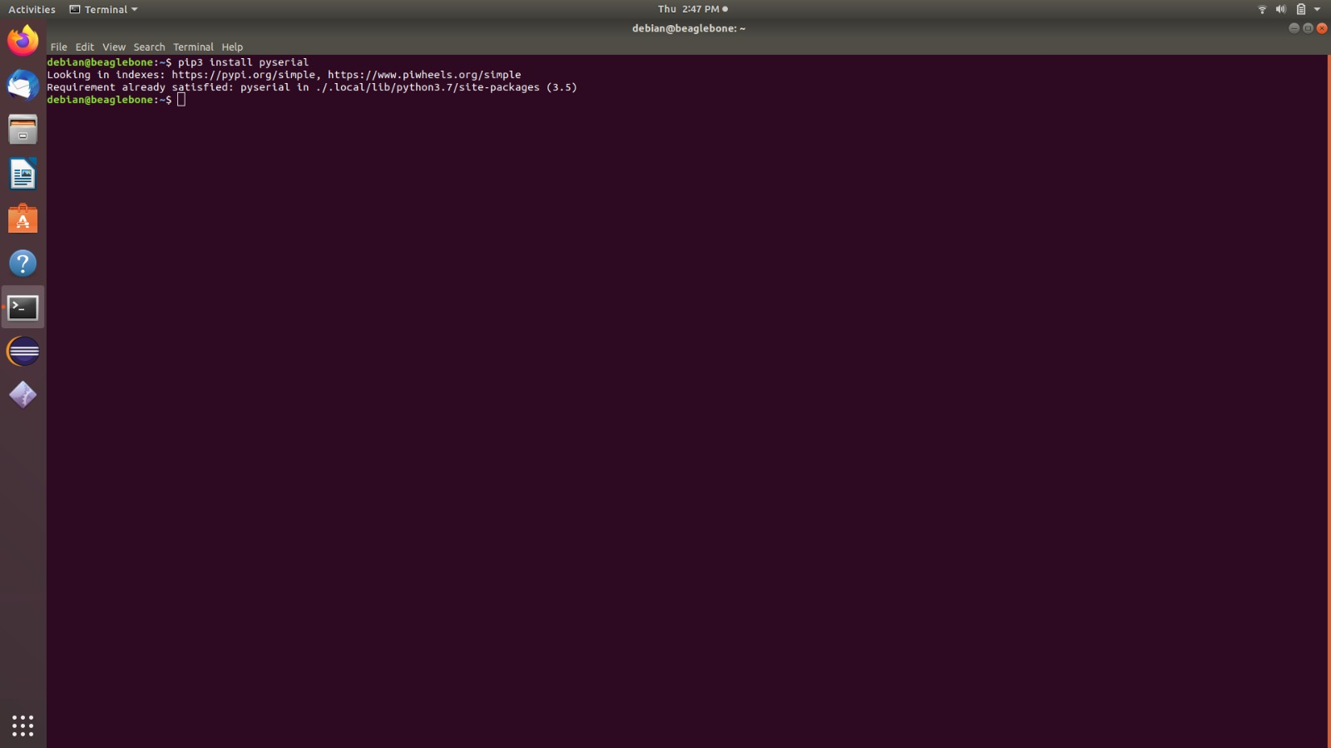
Download Library

Slide 29
Run the Program
We can run the python code with the help of following command:
python3 <file name>

Slide 30
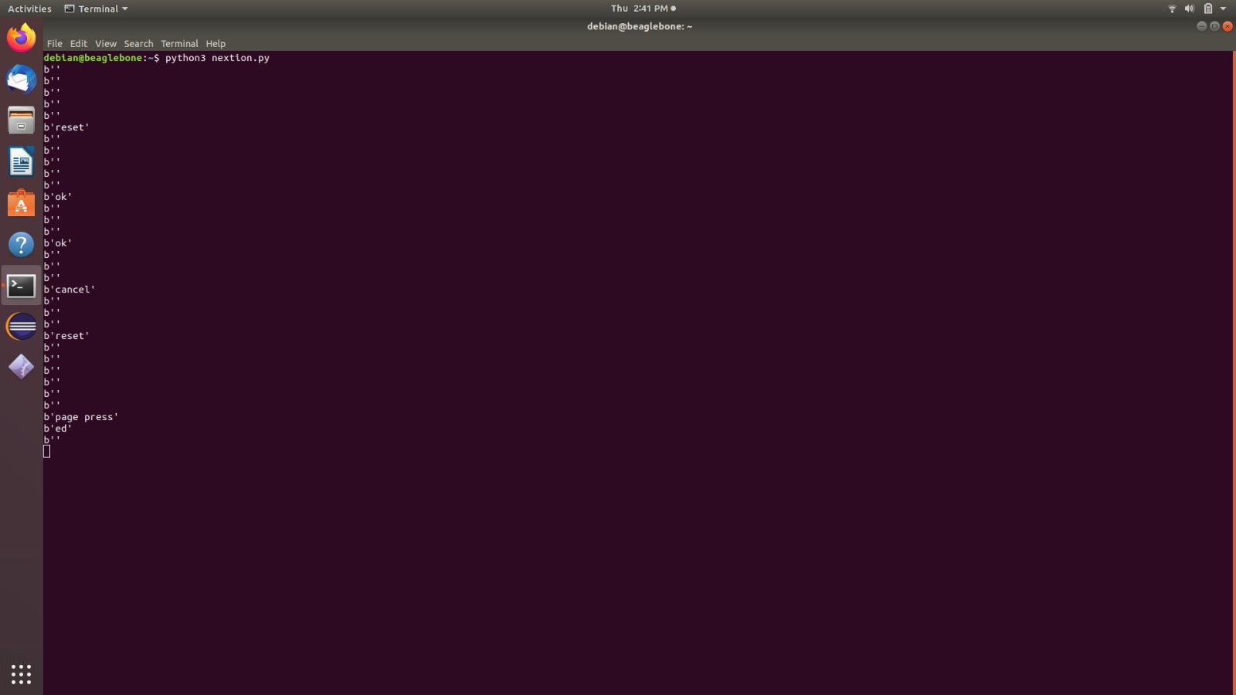
Output:

Slide 31
References:
For installing Library:
https://learn.adafruit.com/setting-up-io-python-library-on-beaglebone-black/uart
Specifications of touch screen display:
https://pl.aliexpress.com/item/32874330873.html
Nextion Ediotr:
https://www.youtube.com/watch?v=qx-aFB3-7SA

Slide 32
References:
Interfacing of BB-WI with touch screen display:
https://www.14core.com/working-with-nextion-hmi-gui-tft-touch-display/
Specifications of BB-WI:
https://beagleboard.org/black-wireless

